Slide 1

FRONT END PROJECT
TITLE: FLIGHT TICKET BOOKING
BY: K.KAMAKEYA
BATCH CODE: 5885
ENROLLMENT NO: EBEON0821423668

Slide 2
OBJECTIVE
The main objective of the Flight Ticket Booking (or) Airlines Reservation System is to manage the details of airlines Tickets,Flights,Customers,Booking Counter,Venders..The purpose of the project is to build an application program to reduce the manual work for managing the airlines Ticket,Flights,Booking,Customer.
The web based booking solution that helps in consolidating data from all airlines through the use of Global distribution systems.

Slide 3

INTRODUCTION
Flight ticket booking(or)airline reservation systems are the systems that allows an airline to sell their seats.it contain information on schedules and fares and contain a database of reservation(or passenger name records) and of tickets issued.It is a part of passenger service system.
It eventually evolved into the computer reservations system.a computer reservation system is used for the reservations of a particular airline and interfaces with a global distribution system which support travel agencies and other distribution channels in making reservations for most major airlines in a single system.

Slide 4
LANGUAGE USED
JAVASCRIPT
CSS
HTML
BOOTSTRAP

Slide 5
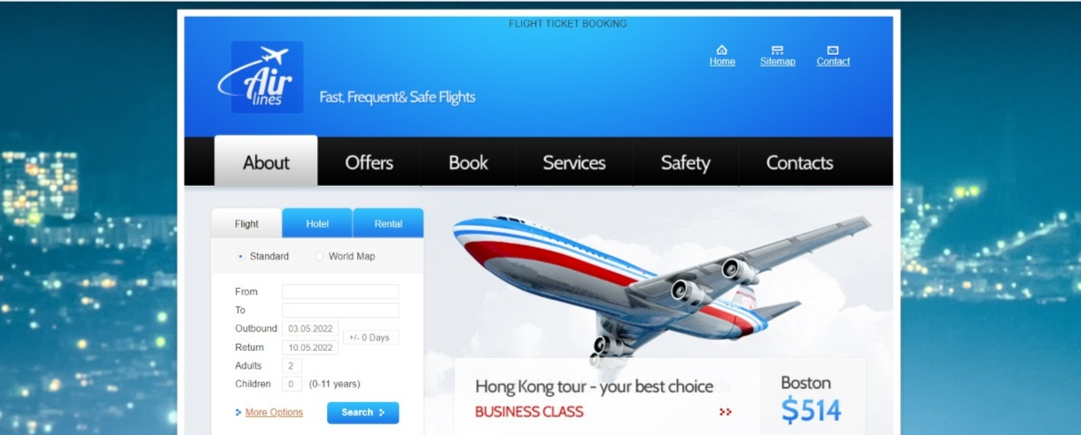
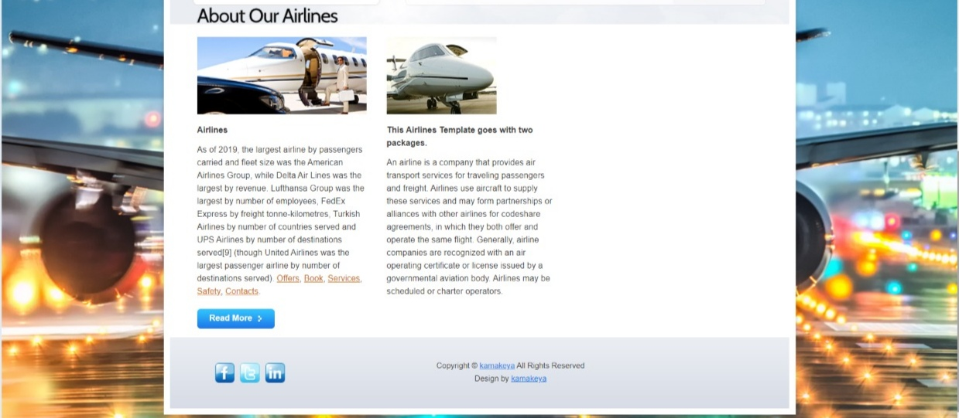
SCREENSHOTS
HOME PAGE: FLIGHT,HOTEL,RENTAL
ABOUT OUR AIRLINES

Slide 6
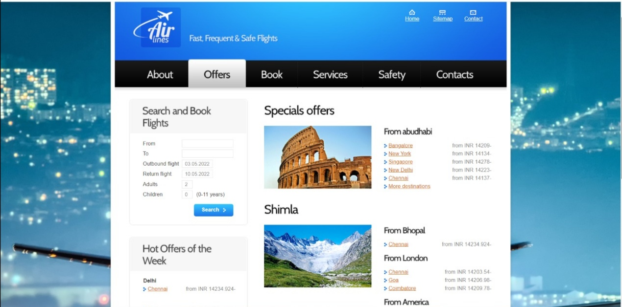
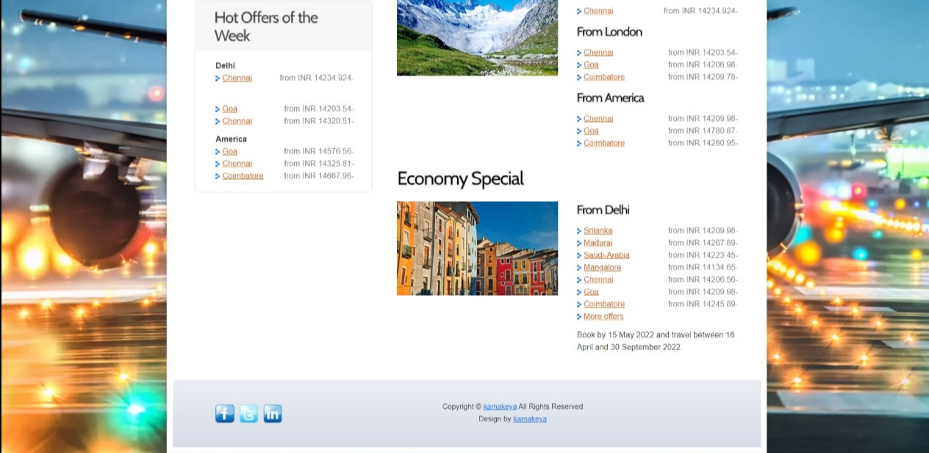
OFFERS
SPECIAL OFFERS
HOT OFFERS OF THE WEEK

Slide 7
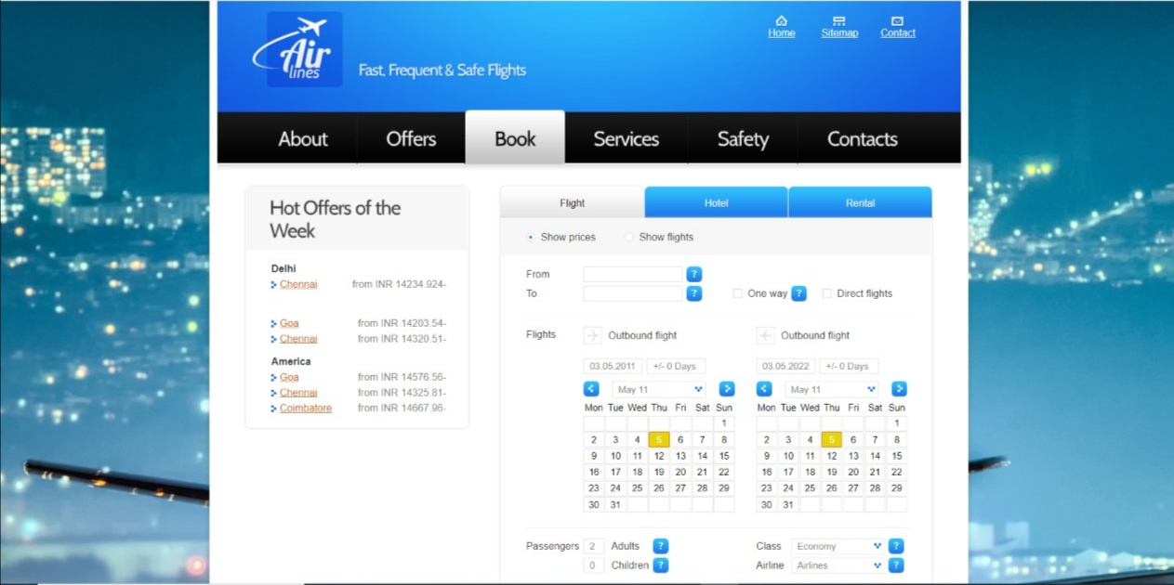
FLIGHT BOOKING FORMATE

Slide 8
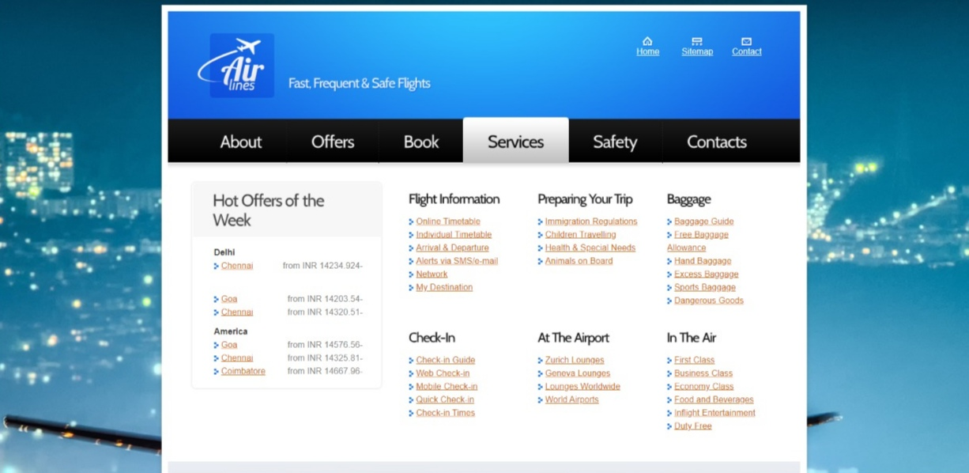
SERVICES TO THE PASSENGERS

Slide 9
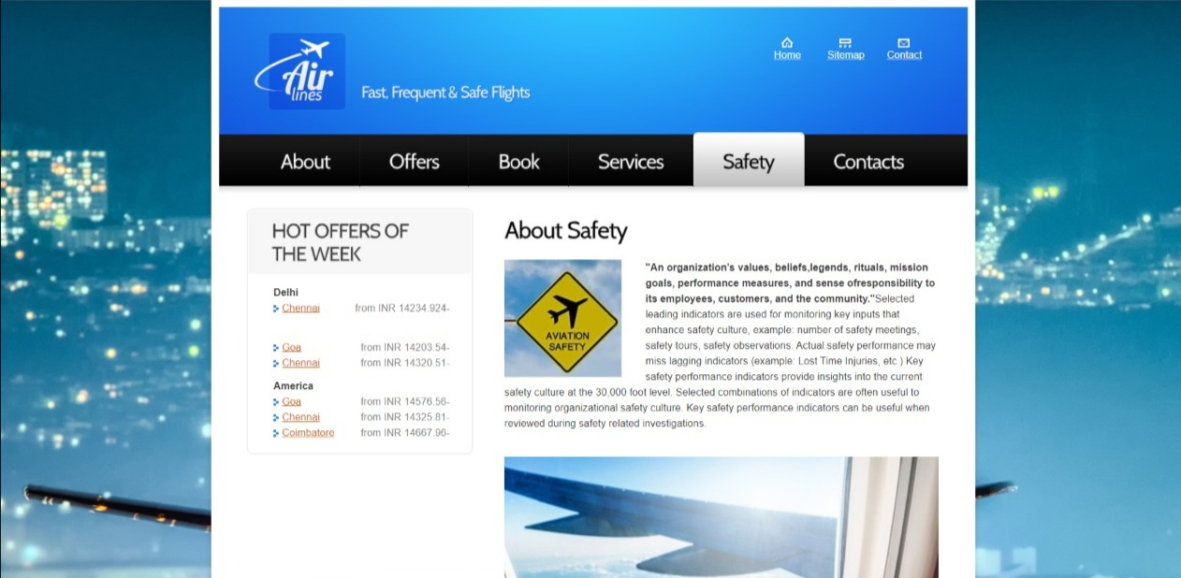
NO SAFETY-KNOW PAIN KNOW SAFETY-NO PAIN

Slide 10
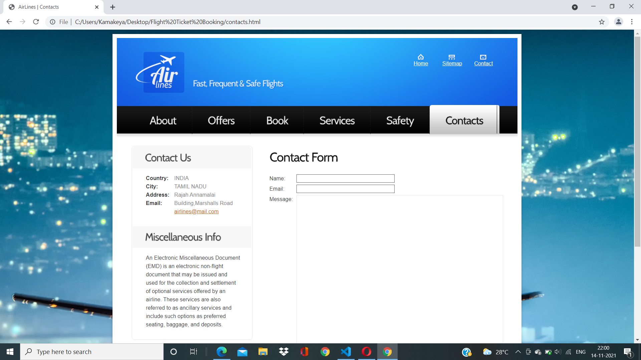
CONTACTS

Slide 11


